Slide 1
MACHINE LEARNING CLUSTERING HDB Scan Clustering

Slide 2
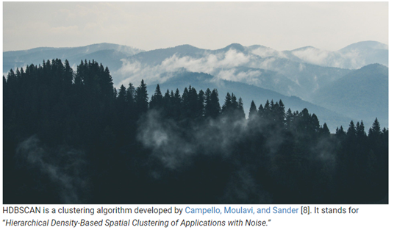

Slide 3
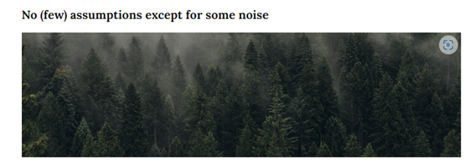


Slide 4
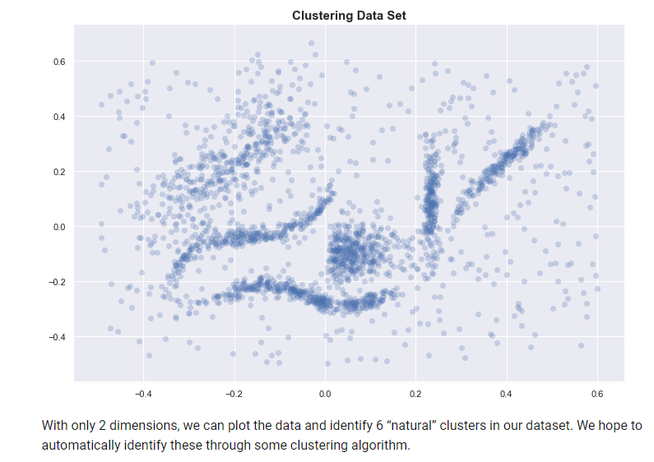

Slide 5
